Slide 1
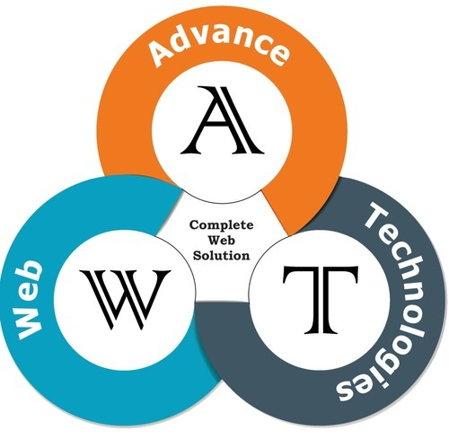

Object Oriented PHP
Department of Computer Engineering
Advance PHP
Unit 1
Object Oriented PHP
Subject Code: 01IT0701
Advance Web Technology
Laravel
Node.js
Prof. Munindra Lunagaria

Slide 2
Outline
Classes
Properties
Methods
Constructor
Destructor
Getter and Setter
Encapsulation
Inheritance
Data Abstraction
Polymorphism

Slide 3
Object Oriented Programming
Procedural programming: Writing procedures or functions that perform operations on the data
Object-oriented programming: Creating objects that contain both data and functions.
Object-oriented programming is a programming model organized around Object rather than the actions and data rather than logic

Slide 4
Why OOP?
Advantages:
Faster and easier to execute
Provides a clear structure for the programs
OOP helps to keep the PHP code DRY "Don't Repeat Yourself“
To make the code easier to maintain, modify and debug
To create full reusable applications with less code and shorter development time

Slide 5
OOP Concepts
Classes
Objects
Inheritance
Polymorphism
Data Abstraction
Encapsulation
Constructor
Destructor

Slide 6
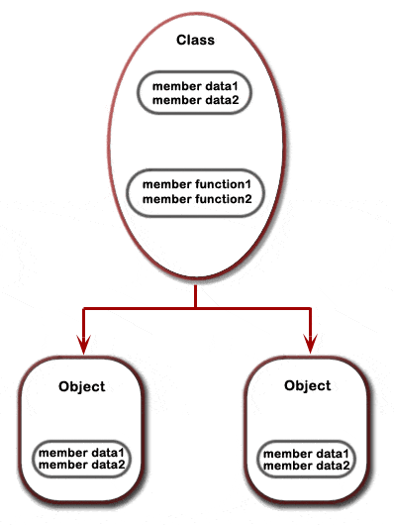
Classes
Programmer-defined data type, which includes local functions as well as local data.
Blueprint or Prototype or a set of instruction to build a specific type of object

Slide 7
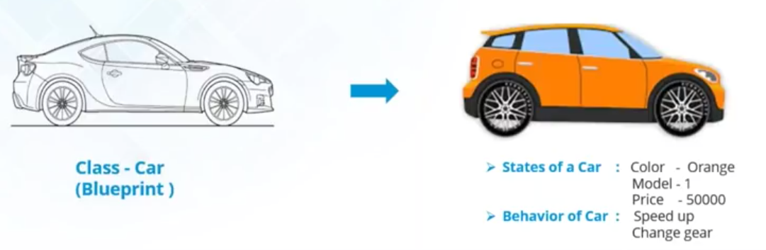
Classes

Slide 8
Classes
The class definition starts with the keyword class followed by a class name, then followed by a set of curly braces({}).
Classes enclose constants, variables (called "properties"), and functions (called "methods") belonging to the class.
Class names usually begin with an uppercase letter to distinguish them from other identifiers.

Slide 9
Syntax of Class
<?php
class Myclass
{
//Add property statements here
//Add the methods here
}
?>
Class = Template for objects
Object = Instance of class

Slide 10
Properties
Class member variables are called properties or attributes or fields.
The properties hold specific data and related with the class in which it has been defined.
Use one of the keyword public, protected, or private followed by a normal variable declaration.
If declared using var (compatibility with PHP 4), the property will be defined as public.

Slide 11
Properties
Properties can be
Public: The property can be accessed from outside the class, either by the script or from another class
Private : No access is granted from outside the class, either by the script or from another class.
Protected : No access is granted from outside the class except a class that’s a child of the class with the protected property or method.

Slide 12
Example
<?php
class Myclass
{
public $font_size =10;
private $font-color=“red”;
protected $font-text=“AWT”;
}
?>

Slide 13
Two ways to initialize properties
Inside the class (by creating method)
Outside the class (by directly changing the property value)

Slide 14
Directly changing the property value
<?php
class books
{
public $title;
}
$PHP_book = new books();
$PHP_book ->title = “Advance PHP”;
?>
Common mistake to use more than one dollar sign when accessing variables

Slide 15
Methods
The functions which are declared in a class are called methods.
A class method is exactly similar to PHP functions.
Use one of the keyword public, protected, or private followed by a method name.
A valid method name starts with a letter or underscore, followed by any number of letters, numbers, or underscores.
Can access properties and methods of the current instance using $this (Format $this->property) for non static property. / or /
The $this keyword refers to the current object, and is only available inside methods.

Slide 16
Example
<!DOCTYPE html>
<html>
<body>
<?php
class Car {
// Properties
public $name;
public $color;
// Methods
function set_name($name) {
$this->name = $name;
}
function get_name() {
return $this->name;
}
function set_color($color) {
$this->color = $color;
}
function get_color() {
return $this->color;
}
}
$audi = new Car();
$audi->set_name('Audi');
$audi->set_color('Black');
echo $audi->get_name();
echo "<br>";
echo $audi->get_color();
?>
</body>
</html>

Slide 17

Var_dump()
It is used to display the structured information(type and value) about one or more objects.
<?php
class fruit{
public $name;
public $color;
}
$obj = new fruit();
$obj ->name=“Orange”;
echo var_dump($obj);
?>

Slide 18
Instanceof()
It is used to check if object belongs to a specific class or not.
<?php
class fruit{
public $name;
}
$obj = new fruit();
echo var_dump($obj instanceof fruit);
?>
Output:
bool(true)

Slide 19
Magic Method: Constructor
A special built-in method, added with PHP 5, allows developers to declare for classes
To initialize object properties ( i.e. the values of properties) when an object is created
Classes which have a constructor method execute automatically when an object is created.
The constructor is not required if you don't want to pass any property values or perform any actions when the object is created.
PHP only ever calls one constructor.

Slide 20
Advantages of Constructor
Encourage re-usability avoiding re-initializing whenever instance of the class is created .
The ability to pass parameters which are helpful in automatic initialization of the member variables during creation time
It can call class member methods and functions.
It can call other Constructors even from Parent class.

Slide 21
Syntax
The 'construct' method starts with two underscores (__)
function __construct([argument1, argument2, ..., argumentN])
{
/* Class initialization code */
}
The type of argument1, argument2,.......,argumentN are mixed.

Slide 22
Example
<?php
class Car {
public $name;
public $color;
function __construct($name, $color) {
$this->name = $name;
$this->color = $color;
}
function get_name() {
return $this->name;
}
function get_color() {
return $this->color;
}
}
$audi = new Car("Audi", "red");
echo $audi->get_name();
echo "<br>";
echo $audi->get_color();
?>

Slide 23
Calling of parent constructor
Two ways to define constructor using "__construct" or same name as class name.
Parent constructors are not called implicitly if the child class defines a constructor. In order to run a parent constructor, a call to parent::__construct()

Slide 24
Calling of parent constructor
<?php
class TC1
{
public function TC1()
{
echo "constructor TC1";
}
}
Constructor using class name
Program Continues…

Slide 25
Calling of parent constructor
Constructor using __construct() method
class Abatch extends TC1
{
public function __construct()
{
echo parent::TC1();
echo "<br>";
echo "constructor A batch";
}
}
$obj= new Abatch();
?>

Slide 26
Magic Method: Destructor
The destructor is the counterpart of constructor.
A destructor function is called when the object is destroyed.
A destructor function cleans up any resources allocated to an object after the object is destroyed.
A destructor function is commonly called in two ways: When a script ends or manually delete an object with the unset() function

Slide 27
Syntax
The destructor method starts with two underscores (__).
Cleaning up of resources before memory release or closing of files takes place in the destructor method, whenever they are no longer needed in the code.
function __destruct
{
//cleanup code
}

Slide 28
Example
<?php
class Car {
public $name;
public $color;
function __construct($name, $color) {
$this->name = $name;
$this->color = $color;
}
function __destruct() {
echo "The Car is {$this->name} and the color is {$this->color}.";
}
}
$apple = new Car("Audi", "red");
?>
The example has a __construct() function that is automatically called when you create an object from a class, and a __destruct() function that is automatically called at the end of the script:

Slide 29
Getter and Setter Methods
Getters and Setters are object methods that allow you to control access to a certain class variables / properties
These functions are referred to as mutator methods
A getter allows to you to retrieve or get a given property.
A setter allows you to set the value of a given property.
If any property has private access modifier then you can not directly called that property so create getter and setter function to access it.

Slide 30
Usage of Getter & Setter
To provide access to our private properties
To add a layer of validation to prevent objects from being misused(see example)

Slide 31
Example
<?php
class Movie
{
public $name;
private $rating;//Not accessible outside the class
function __construct($name, $rating)
{
$this->name = $name;
$this->rating = $rating;
$this->setrating($rating);
}
Program Continues…

Slide 32
Example
function setrating($rating) //setter
{
if($rating == "G" ||$rating == "PG" ||$rating == "PG-13" || $rating == "R" || $rating == "NR")
//only valid rating accepted
{
$this->rating=$rating;
}
else{
$this->rating="NR";
}
}
Program Continues…
Notes:
G=General Audience
PG=Parental Guidance Suggested
PG-13=Inappropriate for child under 13
R=Restricted
NR=Not Rated

Slide 33
Example
function getrating() //getter
{
return $this->rating;
}
}
$ZNMD=new Movie(”ZNMD","G");
echo "Movie rating is:".$ZNMD->getrating();
?>
Notes:
G=General Audience
PG=Parental Guidance Suggested
PG-13=Inappropriate for child under 13
R=Restricted
NR=Not Rated

Slide 34
Encapsulation
Whenever data modified in one function affects the other functions.
To overcome this problem concept of Encapsulation is used.
Enclosing the internal details of the object to protect from external sources.
It’s the bundling of properties and behavior in a single class unit

Slide 35
Encapsulation
Encapsulation can be used if the properties of the object are private and updating them through public methods
Encapsulation in PHP can be achieved using the implementation of access specifiers(Private).
It is very careful about OOPs concept of inheritance as many times inheritance can undermine the concept of encapsulation.
Inheritance exposes some details of a parent class, effectively breaking encapsulation.

Slide 36
Advantages of Encapsulation
Data Hiding and Abstraction
Data security
Reduces complexity
Reusability
Reliability
Easier testing of code
Increased flexibility

Slide 37
Example
<?php
class student{
private $name;
private $gender;
public function setname($name){
$this->name=$name;
echo "Name is ".$name;
echo "<br>";
}
public function setgender($gender){
if($gender == "Male" || $gender == "Female")
{
$this->gender=$gender;
echo "Gender is ".$gender;
}
}
Setter
Setter
Program Continues…

Slide 38
Example
Getter
public function getname(){
return $this->name;
}
public function getgender(){
return $this->gender;
}
}
$Moon = new student();
$ Moon ->setname(”ML");
$ Moon ->setgender(”Male");
?>
Getter

Slide 39
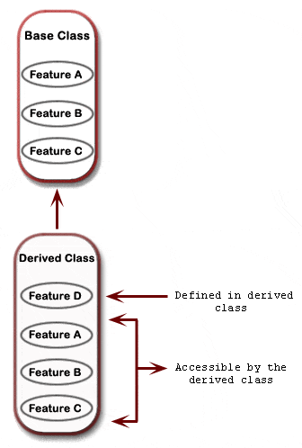
Inheritance

Slide 40
Inheritance
Inheritance = When a class derives from another class.
The child class will inherit all the public and protected properties and methods from the parent class.
Inheritance allows reusing code.
Super class is the base class or parent class
Sub class or derived class or child class can add properties and methods

Slide 41
Inheritance
An inherited class is defined by using the extends keyword.
Types of inheritance
Single inheritance
Multi-level inheritance
Multiple inheritance(Not Supported)

Slide 42
Example
<?php
class books{
public $title;
public $author;
public $price;
public function __construct($t,$a,$p){
$this->title=$t;
$this->author=$a;
$this->price=$p;
}
public function get_values(){
echo "Title is:".$this->title."<br>“;
echo "Author is:".$this->author."<br>”;
echo “Price is:".$this->price;
}
}
Program Continues…

Slide 43
Example
class technicalbooks extends books{
public $publication;
public function set($p){
$this->publication=$p;
}
public function get(){
echo "<br>Publication is:".$this->publication;
}
}
$AWT=new technicalbooks("Advance web Technology", "XYZ","350");
$AWT->set("Mc Grill");
$AWT->get_values();
$AWT->get();
?>

Slide 44
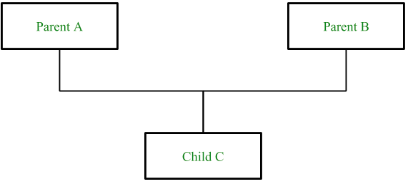
Interface
PHP doesn’t support multiple inheritance but by using Interfaces in PHP or using Traits in PHP instead of classes, we can implement it.

Slide 45
Interface
The class that is fully abstract is called an interface.
An interface is similar to a class except that it cannot contain code.
An interface can define method names and arguments, but not the contents of the methods.
Any classes implementing an interface must implement all methods defined by the interface.
Interfaces can't maintain Non-abstract methods.

Slide 46
Interface
Derived classes may implement more than one interface.
Interfaces may inherit from other interfaces using the extends keyword.
When a class implements multiple interfaces there cannot be any naming collision between methods defined in the different interfaces.
All methods are assumed to be public in the interface definition can be defined explicitly as public or implicitly.

Slide 47
Usage of Interface
To implement multiple inheritance
It referred to as the next level of abstraction(Define method but how is it implemented that is not given)
It ensures to maintain a sort of metadata for all the methods that programmer wishes to work on.

Slide 48
Syntax
interface MyInterface
{
function method1();
function method2();
}
class MyClass implements MyInterface
{
function method1()
{
// definition of method1
}
function method2()
{
// definition of method2
}
}

Slide 49
Example
<?php
interface Getdata{
public function get();
}
interface Printdata{
public function put();
}
class class1 implements Getdata, Printdata{
public function get(){
echo "Get data method is called";
}
public function put(){
echo "<br>Put data method is called";
}
}
$obj=new class1;
$obj->get();
$obj->put();
?>

Slide 50
Traits
What if a class needs to inherit multiple behaviors?
The trait is a type of class which enables multiple inheritance.
Traits are used to declare methods that can be used in multiple classes.
Traits can have methods and abstract methods that can be used in multiple classes, and the methods can have any access modifier
Reduces code duplication because no need to redeclare same methods over and over again

Slide 51
Syntax of Traits
<?php
trait TraitName {
// some code...
}
?>
To use a trait in a class, use the use keyword:
<?php
class MyClass {
use TraitName;
}
?>

Slide 52
Example of Traits
<?php
trait message1 {
public function msg1() {
echo "Trait 1: msg1 called";
}
}
trait message2 {
public function msg2() {
echo "Trait 2: msg2 called";
}
}
Program Continues…

Slide 53
Example of Traits
class class1 {
use message1;
}
class class2 {
use message1, message2;
}
$obj = new class1();
$obj->msg1();
echo "<br>";
$obj2 = new class2();
$obj2->msg1();
echo "<br>";
$obj2->msg2();
?>

Slide 54
Data Abstraction
Abstraction is the any representation of data in which the implementation details are hidden.
An abstract class is a class that contains at least one abstract method.
An abstract method is a method that is declared, but not implemented in the code.
Abstract class can not be instantiated.
Abstract class can contain abstract methods or non-abstract methods or constructors also.

Slide 55
Data Abstraction
When a child class is inherited from an abstract class,
The child class method must be defined with the same name and it redeclares the parent abstract method.
The child class method must be defined with the same or a less restricted access modifier.
The number of required arguments must be the same. However, the child class may have optional arguments in addition.

Slide 56
Syntax of Abstract class
An abstract class or method is defined with the abstract keyword:
<?php
abstract class ParentClass {
abstract public function someMethod1();
abstract public function someMethod2($name, $color);
public function someMethod3(){
//Some code here
}
}
?>

Slide 57
Example of Abstract class
<?php
abstract class class1 {
abstract protected function prefixName($name);
}
class class2 extends class1 {
public function prefixName($name) {
if ($name == ”Moon") {
$prefix = "Mr.";
} elseif ($name == ”Munindra") {
$prefix = ”Mr.";
} else {
$prefix = "";
}
return "{$prefix} {$name}";
}
}
Program Continues…

Slide 58
Example of Abstract class
$class = new class2;
echo $class->prefixName(”Munindra");
echo "<br>";
echo $class->prefixName(”Moon");
?>

Slide 59
Spl_autoload_register()
spl = Standard PHP library is collection of classes and interfaces to solve common problems.
One of the biggest annoyances is having to write a long list of needed includes at the beginning of each script (one for each class).
__autoload() function was used to automatically load classes.
As of PHP 5.1.2 a new function spl_autoload_register() is introduced which provides a more flexible alternative for autoloading classes.

Slide 60
Syntax of Spl_autoload_register()
bool spl_autoload_register ([ callable $autoload_function [, bool $throw = true [, bool $prepend = false ]]] )
autoload_function: The autoload function being registered. If no parameter is provided, then the default implementation of spl_autoload() will be registered.
Throw: spl_autoload_register() should throw exceptions when the autoload_function cannot be registered.
Prepend: If true, spl_autoload_register() will prepend the autoloader on the autoload stack instead of appending it.

Slide 61
Example of Spl_autoload_register()
Class1.php
<?php
class class1{
private $font_color;
private $font_text;
function __construct($f,$s){
$this->font_color=$f;
$this->font_text=$s;
$this->print_msg();
}
function print_msg(){
echo "<p style=color:".$this->font_color.";>".$this->font_text."</p>";
}
}
?>

Slide 62
Example of Spl_autoload_register()
Class2.php
<?php
class class2{
private $font_size;
private $font_text;
function __construct($f,$s){
$this->font_size=$f;
$this->font_text=$s;
$this->print_msg();
}
function print_msg(){
echo "<p style=font-size:".$this->font_size.";>".$this->font_text."</p>";
}
}
?>

Slide 63
Example of Spl_autoload_register()
autoload.php
<?php
spl_autoload_register(function($class)
{
include $class. '.php';
});
$p1=new class1("red","AWT");
$p1=new class2("28","AWT");
?>

Slide 64
Object Cloning
Cloning is used to create a copy of an object by using the clone keyword.
When an object is cloned, PHP 5 will perform a shallow copy of all of the object's properties.
Any properties that are references to other variables, will remain references.
PHP provides a special method __clone to copy an object.
if a __clone() method(magic method) is defined, then the newly created object's __clone() method will be called, to allow any necessary properties that need to be changed.

Slide 65
Example of Object Cloning
<?php
class class1{
public $x;
private $y;
public function __construct($x,$y){
$this->x=$x;
$this->y=$y;
}
function __clone(){
$this->x="Z";
}
}
$a = new class1("AWT","Sem 7");
$b = clone $a;
var_dump($a);
echo "<br>";
var_dump($b);
?>

Slide 66
PHP: Magic Methods
PHP reserves all function names starting with __ as magical.
__call(): It is triggered when invoking inaccessible methods in an object context.
Syntax : public mixed __call ( string $name , array $arguments )
__callStatic(): It is triggered when invoking inaccessible methods in a static context.
Syntax : public mixed __call ( string $name , array $arguments )

Slide 67
PHP: Magic Methods
__get(): It is utilized for reading data from inaccessible properties.
Syntax : public mixed __get ( string $name )
__set(): It is run when writing data to inaccessible properties.
Syntax : public void __set ( string $name , mixed $value )
__isset(): It is triggered by calling isset() or empty() on inaccessible properties.
Syntax : public bool __isset ( string $name )

Slide 68
PHP: Magic Methods
__unset(): It is invoked when unset() is used on inaccessible properties.
Syntax : public void __unset ( string $name )
__sleep(): It is used to commit pending data or perform similar cleanup tasks. Also, the function is useful if you have very large objects which do not need to be saved completely.
Syntax : public array __sleep ( void )
__wakeup(): It is used to reestablish any database connections that may have been lost during serialization and perform other reinitialization tasks.
Syntax : void __wakeup ( void )

Slide 69
PHP: Magic Methods
__toString(): This method allows a class to decide how it will react when it is treated like a string.
Syntax : public string __toString ( void )
__invoke(): This method is called when a script tries to call an object as a function.
Syntax : mixed __invoke ([ $... ] )
__set_state(): This static method is called for classes exported by var_export() since PHP 5.1.0.
Syntax : static object __set_state ( array $properties )

Slide 70
PHP: Magic Methods
__clone(): As discussed earlier.
__construct(): As discussed earlier.
__destruct(): As discussed earlier.

Slide 71
Polymorphism
Poly (meaning many) and morph (meaning forms).
A class has varying functionality while sharing a common interfaces
Two types of Polymorphism; they are:
Compile time (function overloading)
Run time (function overriding)

Slide 72
Polymorphism
Method Overloading: Same method name with different signature, since PHP doesn't support method overloading concept (magic method __call() is used to achieve this)
Method Overriding: When same methods defined in parents and child class with same signature i.e know as method overriding

Slide 73
Example of Run time Polymorphism(Method Overriding)
<?php
interface Shape1 {
public function calcTask();
}
class Circle implements Shape1 {
private $radius;
public function __construct($radius){
$this -> radius = $radius;
}
public function calcTask(){
return $this -> radius * $this -> radius * pi();
}
}
Program Continues…

Slide 74
Example of Run time Polymorphism(Method Overriding)
class Rectangle implements Shape1 {
private $width;
private $height;
public function __construct($width, $height){
$this -> width = $width;
$this -> height = $height;
}
public function calcTask(){
return $this -> width * $this -> height;
}
}
$mycirc = new Circle(3);
$myrect = new Rectangle(3,4);
echo "Area of circle is: ".$mycirc->calcTask()."<br>";
echo "Area of rectangle is: ".$myrect->calcTask();
?>

Slide 75
THANK YOU

